Slide 1
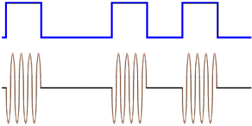
Lecture 8: Modulating Digital Input and Shift Keying
Introduction
Modulation of a digital signal is the process of converting data signals or low-pass analog signals to higher frequency signals. (See figure 37 below):

Slide 2
Digital to analog modulation is used in the transmission of data over the telephone line. There are three basic techniques used for the transmission of data over the telephone systems:
Amplitude shift keying (ASK)
Frequency shift keying (FSK)
Phase shift keying(PSK)
Quadrature amplitude modulation (QAM)

Slide 3
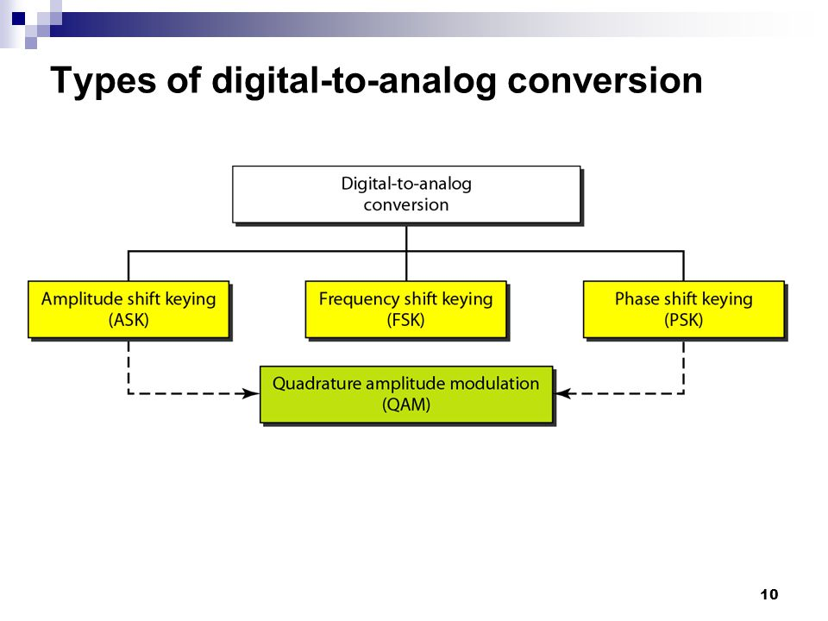

Slide 4
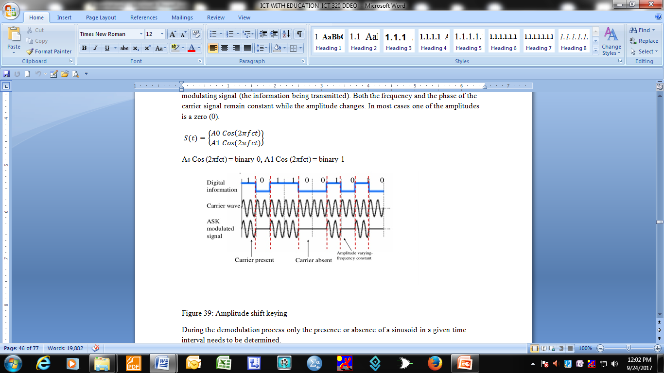
Amplitude Shift Keying
The carrier signal is varied to represent binary 1 or 0 depending on the modulating signal (the information being transmitted).
Both the frequency and the phase of the carrier signal remain constant while the amplitude changes. In most cases one of the amplitudes is a zero (0).

Slide 5
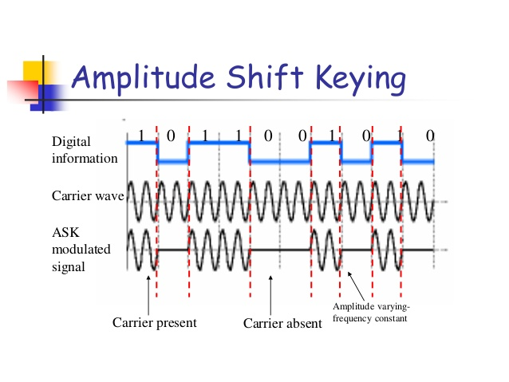
Amplitude Shift Keying

Slide 6
During the demodulation process only the presence or absence of a sinusoid in a given time interval needs to be determined.
Advantages and disadvantages
The major advantage of amplitude frequency shift keying is its simplicity.
The disadvantages include: susceptibility to noise interferences. Noise usually affects the amplitude, so ASK is the modulation techniques most affected by the noise.

Slide 7
Frequency Shift Keying (FSK)
In FSK technique, the frequency of the carrier signal is varied to represent a binary 1 or 0. The peak amplitude and the phase remain constant during each bit interval.

Slide 8
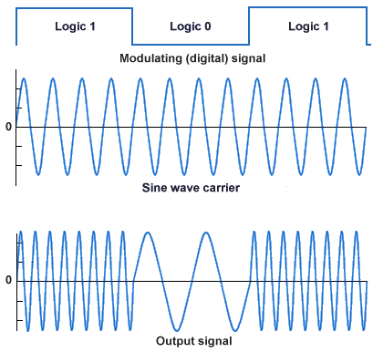
Frequency Shift Keying

Slide 9
In the FSK technique, the modulator should be able to determine which of he two possible frequencies is present at a given period
Advantage
The FSK technique is less susceptible to errors than the ASK. The receiver looks for specific frequency changes over a number of intervals, so voltage (noise) spikes can be ignored.
Disadvantage
The FSK spectrum is twice the ASK spectrum i.e. 2 x ASK spectrum.

Slide 10
Phase Shift Keying (PSK)
Here the phase of the carrier signal is varied to represent a binary 1 or a binary 0.
The peak amplitude and frequency remain constant during each bit interval, for example binary 0 = Oº, binary 1 = 180º.
The phase shift technique is equivalent to multiplying a carrier signal by +1 when information is a binary 1 and by a -1 when information is 0.

Slide 11
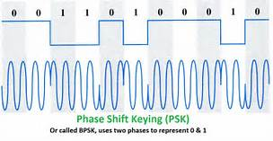
Phase Shift Keying

Slide 12
The modulator must determine the phase of the received sinusoid with respect to some reference phase.
PSK is less susceptible to errors than ASK and it occupies the same bandwidth as ASK. It has more efficient use of the bandwidth (higher data rates) compared to FSK
The disadvantage is that is has more complex signal detection/recovery process than both ASK and FSK.

Slide 13
Quadrature Phase Shift Keying
This technique is a combination of ASK and PSK and PSK uses phase shifts of 90º (π/2) radian, to produce four different signals that are generated each representing 2 bits. For example:
Acos (2πfct) binary 00
A cos (2π (2πfct+π/2) binary 01
A cos (2πfct + π) binary 10
Acos (2πfct + 3π/2), 11

Slide 14
Dibit Phase
00 0°
01 90°
10 180°
1 1 270°
These phase shifts can also be represented by a constellation diagram.

Slide 15
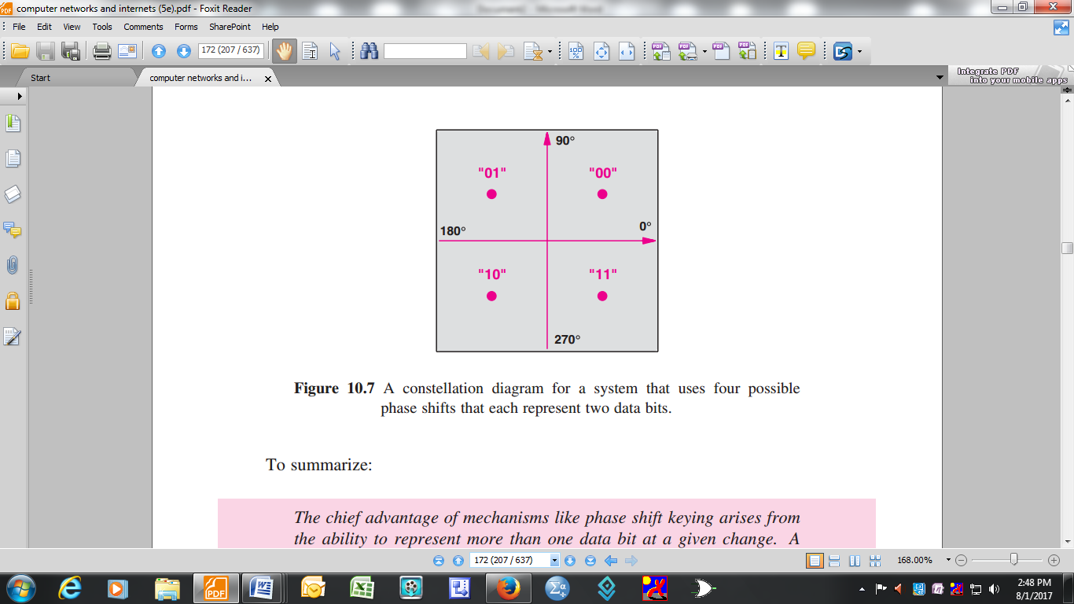
A constellation diagram

Slide 16
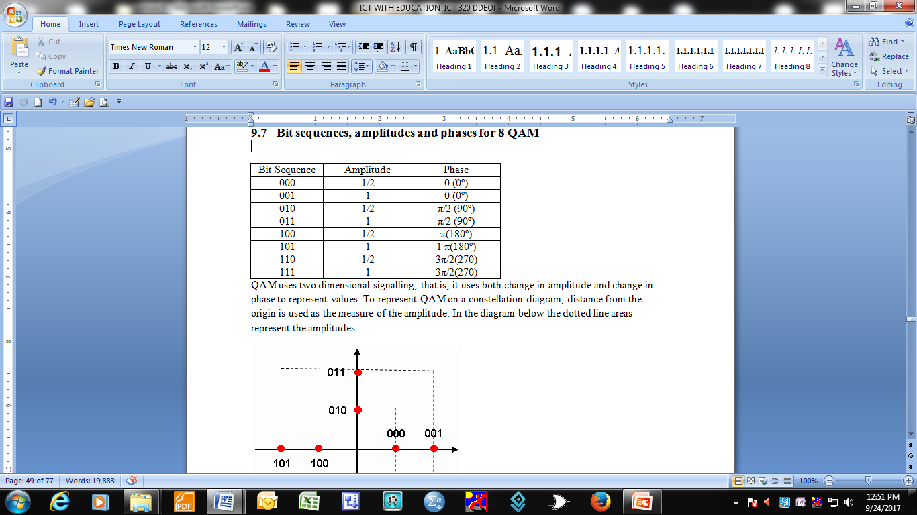
Bit sequences, amplitudes and phases for 8 QAM

Slide 17
